Slide 1


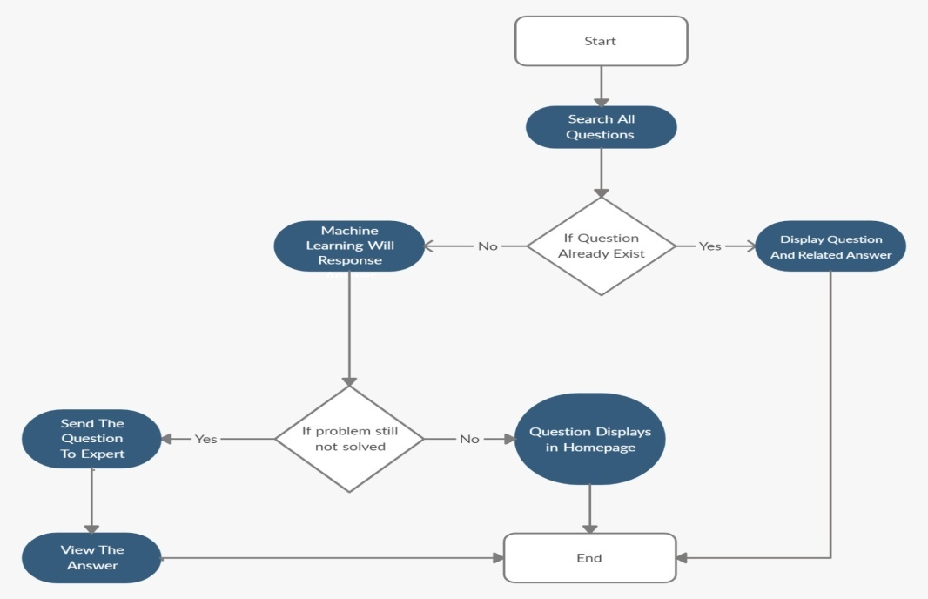
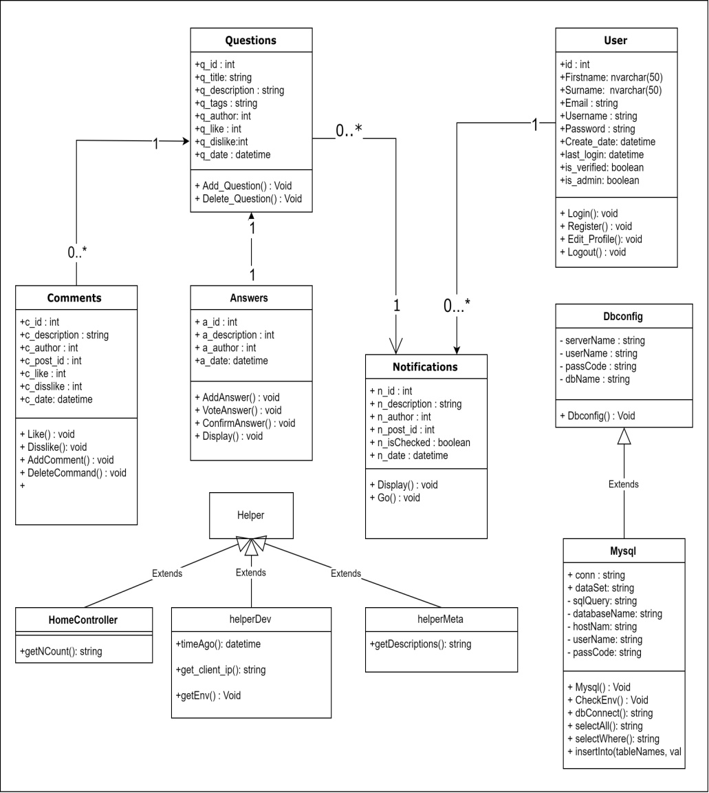
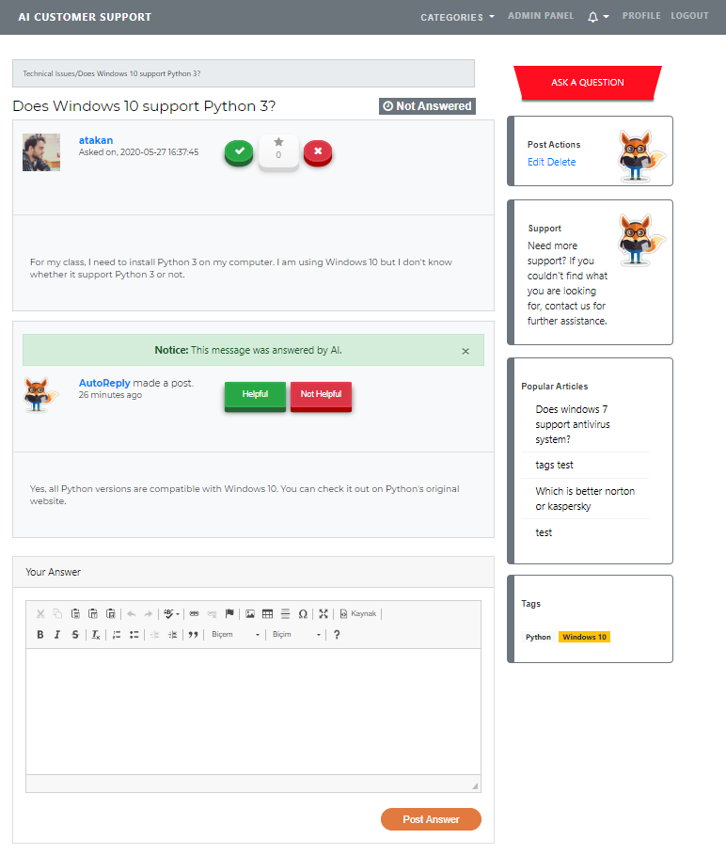
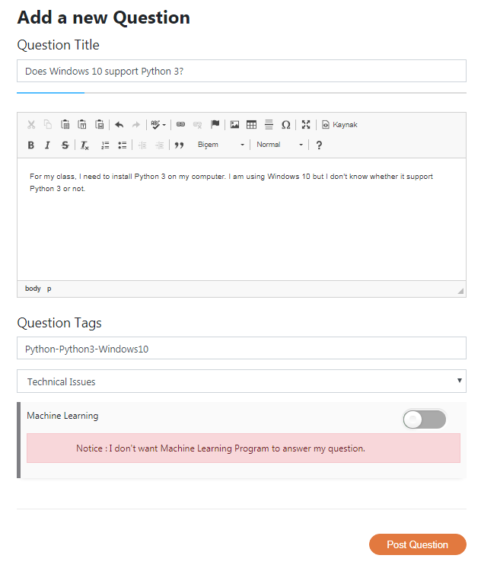
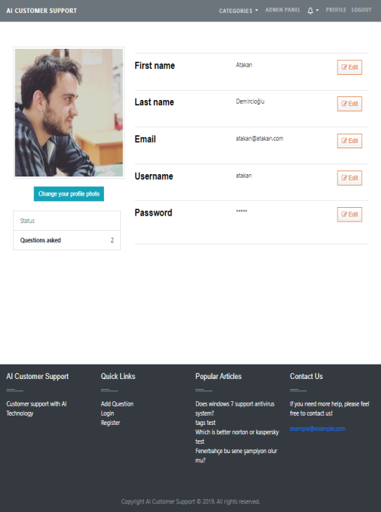


AI CUSTOMER SUPPORT SYSTEM
Alperen Sarınay - Arınç Alp Eren
Atakan Demircioğlu
Muhammed Cavid Aydın
Assist. Prof. Dr. Roya CHOUPANI
Çankaya University, Department of Computer Engineering
Abstract
We design a web-based customer support system that using machine learning. With our project, we aim to reduce the time wasted and cost of customer service. Artificial Intelligence will respond to the customer's questions quickly and accurately with a solution focus.
Company Info
It was established to keep up with the developing technology and to minimize the support costs of the companies. By combining AI solutions and web solutions, we offer both convenient and easy systems.
Results & Conclusion
We have created a web system that can be installed on any website. In our system, we have created a customer support system, a machine learning based program that can train itself according to the questions asked and the answers given by non-machine (human) fans. For each website, our program will have its own data set on the computer where it is installed. For every resolved problem that means the question and the correct answers at the end (how many questions are asked between these two questions, and the right or wrong answers between these two are not important), the machine learning program will create a model and after a while it will start answering the questions. In addition, our program can only understand the English language.
Introduction
Nowadays, most successful companies provide customer service. A customer support system helps an organization manage customer service requests and interact with customers to resolve them. Customers receive answers to their questions or seek solutions to their problems. Company officials also try to solve problems. It is a very challenging stage for companies to answer questions in a continuous, uninterrupted, accurate and fast manner. Continuous live support to customers is a very high cost. We will work on a much more practical system to reduce the cost of this service. We want to solve the problems of people in this area easier, faster and more accurately. Customers will not expect their questions to be answered by the authorities. They will receive quick answers directly generated by the system. Customers will not expect their questions to be answered by the authorities. They will receive quick answers directly generated by the system. We think this is very important for customer satisfaction.
Figure 1 - Flowchart
Acknowledgement
In the process of development of the project, we would like to thank our advisor Roya CHOUPANI.
Figure 2 – Class Diagram
Solution
Data is the lifeblood of all business. Data-driven decisions increasingly make the difference between keeping up with competition or falling further behind. Machine learning can be the key to unlocking the value of corporate and customer data and enacting decisions that keep a company ahead of the competition. We asked to ourselves, why don't we use the questions and answers asked to companies as data? When companies integrate our system, they will use machine learning in the background so that they can provide automatic answers to customers in the live support system. In our project’s machine learning part, we want to use Python as a programming language. In the light of the information we have found from different source throughout our research, 9 out of 10 sources put Python first. The reasons behind our Python decision are the existence of a massive number of frameworks and libraries for machine learning and great source of information on the internet.
Dataset is consist of two rows which are ‘Question’ & ‘Answer’. Dataset can be provided by the company. If not, dataset will be created by the system or purchased from online. Big companies like Amazon have the data we want on the online.
Figure 4 – Finished Product
Figure 3 – Finished Product
Figure 5 – Company Logo

